Slide 1

Multidisciplinary Research Panel Series
October 19, 2018
Multidisciplinary Research in the Field of Substance Abuse:
Innovative Strategies & Lessons learned
Moderator:
Cathleen A. Lewandowski (Social Work)
Panelists:
Wendy Regoeczi (Criminology, Anthropology & Sociology)
Patricia Stoddard-Dare (Social Work)
Miyuki Tedor (Criminology, Anthropology & Sociology)

Slide 2
Panel Abstract
This panel will discuss a range of multidisciplinary projects and research designed to improve the efficiency of substance abuse treatment and overall treatment outcomes.
Panelists will describe their projects and the benefits of multidisciplinary research to improve practice.
They will also discuss the barriers they encountered in developing community-engaged multidisciplinary partnerships, and strategies used to address them.

Slide 3
PROJECTS & COMMUNITY PARTNERS
Project | Researcher(s) | Community Partners
Impact of Medical Legal Partnerships on Social Determinants of Health | Cathleen A. Lewandowski | St. Vincent Charity Medical Center Legal Aid Society
Examining Trends over Time in Homicides, Suicides and Drug Overdoses | Wendy Regoeczi | Dr. Gilson, Cuyahoga County Medical Examiner’s Office Vince Caraffi, County Health Dept.
Drughelp.care | Patricia Stoddard-Dare Miyuki Tedor | Multiple

Slide 4
Medical Legal Partnership
Assessing the Impact of Medical Legal Partnership on the Social Determinants of Health for Substance Abuse, Behavioral Health & General Medical Patients
Researcher: Cathleen A. Lewandowski
Funding: Contract with St. Vincent Charity Medical Center

Slide 5
MLP Purpose and Goals
Purpose: Understand the impact of MLP on social determinants of health for substance abuse and behavioral health
Short-Term Goal: Resolve legal problems affecting SA recovery & other health outcomes
Medium-Term: Improved substance abuse outcome, e.g. decrease recidivism & lapses, increase recovery
Long-Term: Improve patients’ physical and mental health

Slide 6
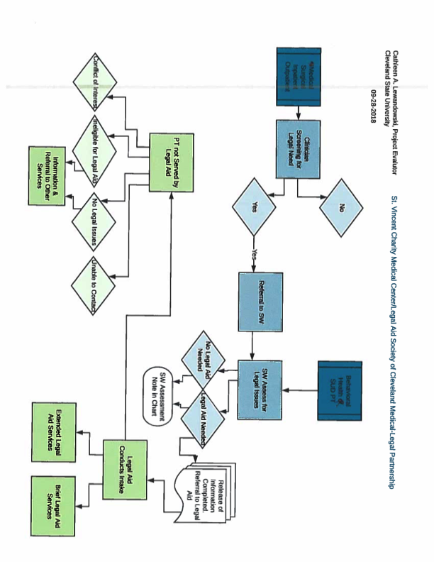
MLP SVCMC Flow Chart

Slide 7
Progress & Findings
Most SVCMC substance abuse and behavioral health providers have been trained on MLP and are making regular referrals
Two Legal-Aid Attorneys providing legal services at SVCMC
90 referrals since October 2017
34 open cases
Primary legal issues: housing, insurance, mental health, family stability

Slide 8
MLP Barriers & Broader Contexts
Barriers
Broader Contexts
Developing a language for multidisciplinary communication: social work, legal, medical, substance abuse professionals
Resolving issues of confidentiality for patients and for research
Implementation is adapting a national model to SVCMC in Cleveland
Opioid crisis poses unique challenges & opportunities to demonstrate benefits of the model in reducing opioid abuse and promoting recovery

Slide 9
Homicide, Suicide & Drug Overdose Trends
Examining Trends over Time in Homicides, Suicides and Drug Overdoses
Researcher: Wendy Regoeczi

Slide 10
Project Overview
Homicide, suicide, and drug overdoses pose significant public health problems nationally and locally.
According to the Centers for Disease Control, there were 15,872 homicides, 42,826 suicides, and 47,055 drug overdose deaths in the United States in 2014.
All three types of death have increased nationally over the past several years.
  Cuyahoga County that has been hit very hard by the recent opioid/opiate epidemic.
  Cleveland has seen a significant rise in homicides over the past several years.
  Are these trends related?

Slide 11
Progress and Preliminary Results
Obtained data from Cuyahoga County Medical Examiner’s Office on drug overdoses (by type) and homicides broken down by race and gender.
Calculated rates by subgroups to graph over time.
Used drug overdose data to examine changes in drug overdoses by type of drug over time.

Slide 12
Rates per 100,000 of Homicide and Drug Overdoses
Cuyahoga County, 2000-2016
(Source: Cuyahoga County Medical Examiner’s Office)

Slide 13
Drugs Present in Overdose Deaths in Cuyahoga County, 2000-2016
(Source: Cuyahoga County Medical Examiner’s Office)

Slide 14
Racial Differences in Homicides and Drug Overdoses
The white homicide rates fluctuate over the time period examined, peaking in 2007 at a rate of 5.76 per 100,000 and falling to its lowest rate in 2010 at 2.55 per 100,000.
The white drug overdose rate shows a rapid increase beginning in 2010. The rate more than doubles between 2015 and 2016.

Slide 15
White Rates of Homicide and Drug Overdoses in Cuyahoga County, 2000-2016
(Source: Cuyahoga County Medical Examiner’s Office)

Slide 16
Racial Differences in Homicides and Drug Overdoses
Black homicide and overdose rates show a sizeable increase between 2015 and 2016.
The black homicide rate grows almost threefold from 2000 (with a rate of 12.81 per 100,000) to 2016 (with a rate of 38.68 per 100,000) and is higher than the black overdose rate in all but two years.
The black drug overdose rate also increases significantly from 13.33 per 100,000 in 2000 to 33.23 per 100,000 in 2016.

Slide 17
Black Rates of Homicide and Drug Overdoses in Cuyahoga County, 2000-2016
(Source: Cuyahoga County Medical Examiner’s Office)

Slide 18
Discussion: Broader Context
Understanding the interrelationships among certain causes of death requires drawing on criminological, medical, and public health perspectives.
An interdisciplinary perspective can help shed light on how trends in homicides, suicides, and drug overdoses, which are often studied independently, can be driven by common forces.

Slide 19
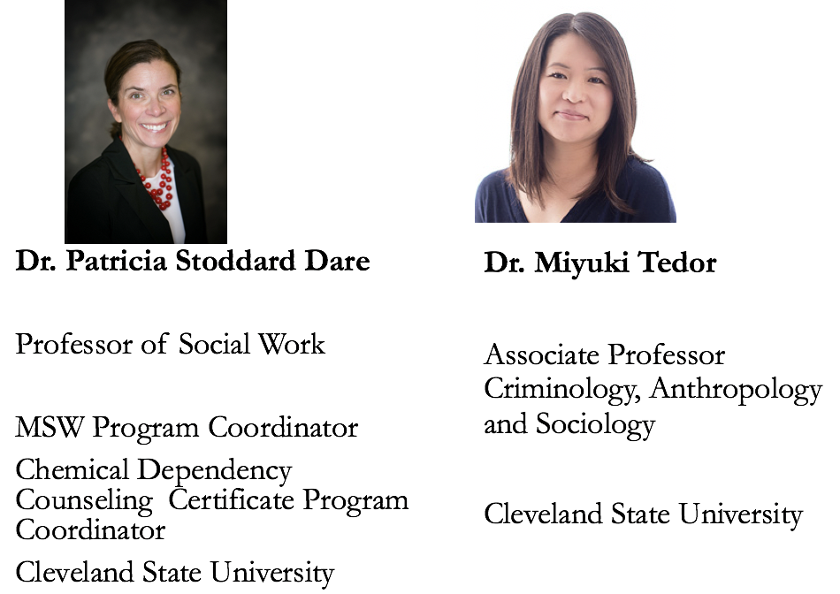

Drughelp.care Research & Students

Slide 20

Drughelp.care Funding
Center for Behavioral Health Sciences Center Pilot Grant, Cleveland State University, $5,000
Faculty Research and Development Grant IoT, Cleveland State University, $8,000
Woodruff Foundation, $20,000

Slide 21
Community Partners and | Contributors
United Way 211 (Diane Gatto) | Services (Jefferey Harraman, Bryan Kloss, Mark Christie)
Hitchock Center (Dorothy Hillarie) | Assist (Jim Coyne, also affiliated with Onix)
ADAMHs board (Scott Osecki, and Valeria Harper) | Thrive Behavioral Health (Craig Dunson)
Metro Health (Dr. Joan Papp) | Cover2 Resources (Greg McNeil)
Opiate Taskforce, (Vince Caraffi) | Emerald Jenny Foundation (Bill Ayers)
MHAC (Joan Englund) | CareSource
Care Alliance Health Center (Elease Sawyers President and CEO) | Safe Passages (Pat Greenhill)
ASCENT (Brian Bailys founder, ACHESS) | St Vincents (Orlando Howard and Carrie Lange)
Judge Patrick Carrol | Louis Stokes VA, Addiction recovery center (Dr. Kevin Smith)
Ohio Guidestone (Larraine Stehlik) | New Directions (Mike Matoney)
Circle Health/Syringe Exchange program (Lisa Fair) | Recovery Resources (Pam Gill)

Slide 22
Purpose: Addressing these Problems
Currently it takes an inordinate amount of time to secure treatment, or the next stage of treatment for individual seeking substance abuse treatment
Treatment providers, clients, and their family members often call countless treatment providers in search of treatment that matches their needs
Significant amount of agency resources goes toward calling around to secure next stage of treatment

Slide 23
PHASE 1 PURPOSE & GOALS
Create a web application that allows treatment providers to easily log their available treatment slots and waitlist data daily
Create a web application that allows treatment providers and first responders to easily find available, compatible, treatment options for clients seeking substance abuse treatment
  We expect this will free up a significant amount of treatment provider time which they can then spend on counseling-related tasks
  This maximizes the likelihood that treatment is initiated while the individual in need is motivated to engage in treatment
  Increase traffic to specific treatment providers when they have available treatment spaces, maximizing their capacity
Register at least 3 new agencies every 2 weeks; 100 agencies over 12 months

Slide 24
PHASE 2 & 3 GOALS
PHASE 2:
Develop app for use by individuals in need of treatment, their friends and family members, and other lay people
Follow a similar process of collecting information from projected app users to inform the development of the app
PHASE 3:
Expand the app by registering treatment providers throughout the state of Ohio

Slide 25
Drughelp.care Progress and Initial Application
Met with web developer regularly to discuss feasibility of what’s possible and how to develop the specs
Deployed a beta version of the app
Hired two enrollment specialists to use the app
Public unveiling Opiate Taskforce + ADAMHS board meetings; letter from ADAMHS board CEO to solidify agency support and enrollment
Enrollment specialist and the web developer attend initial enrollment meetings as we fine-tune the app
Continue to refine app and enroll agencies

Slide 26
Drughelp.care Initial Result
Made the app user friendly and easy to quickly update on a daily basis

Slide 27
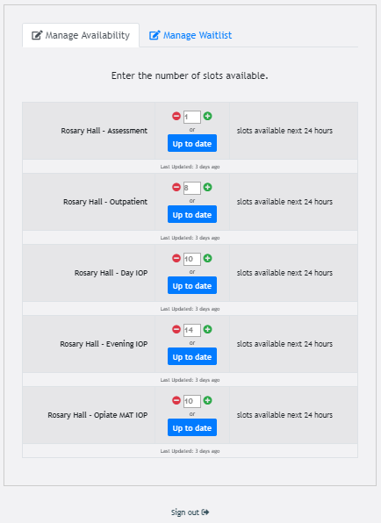
Agencies update available treatment slots daily (in less than 2 minutes)

Slide 28
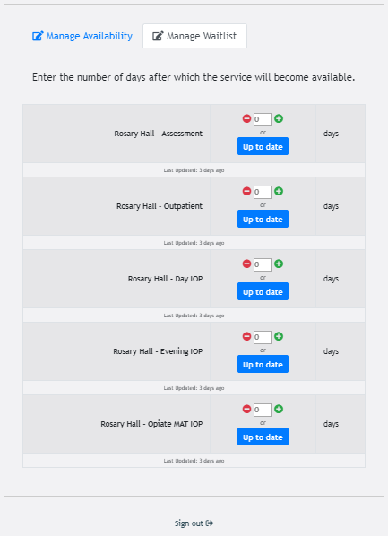
Agencies also indicate waitlist length (in days)

Slide 29
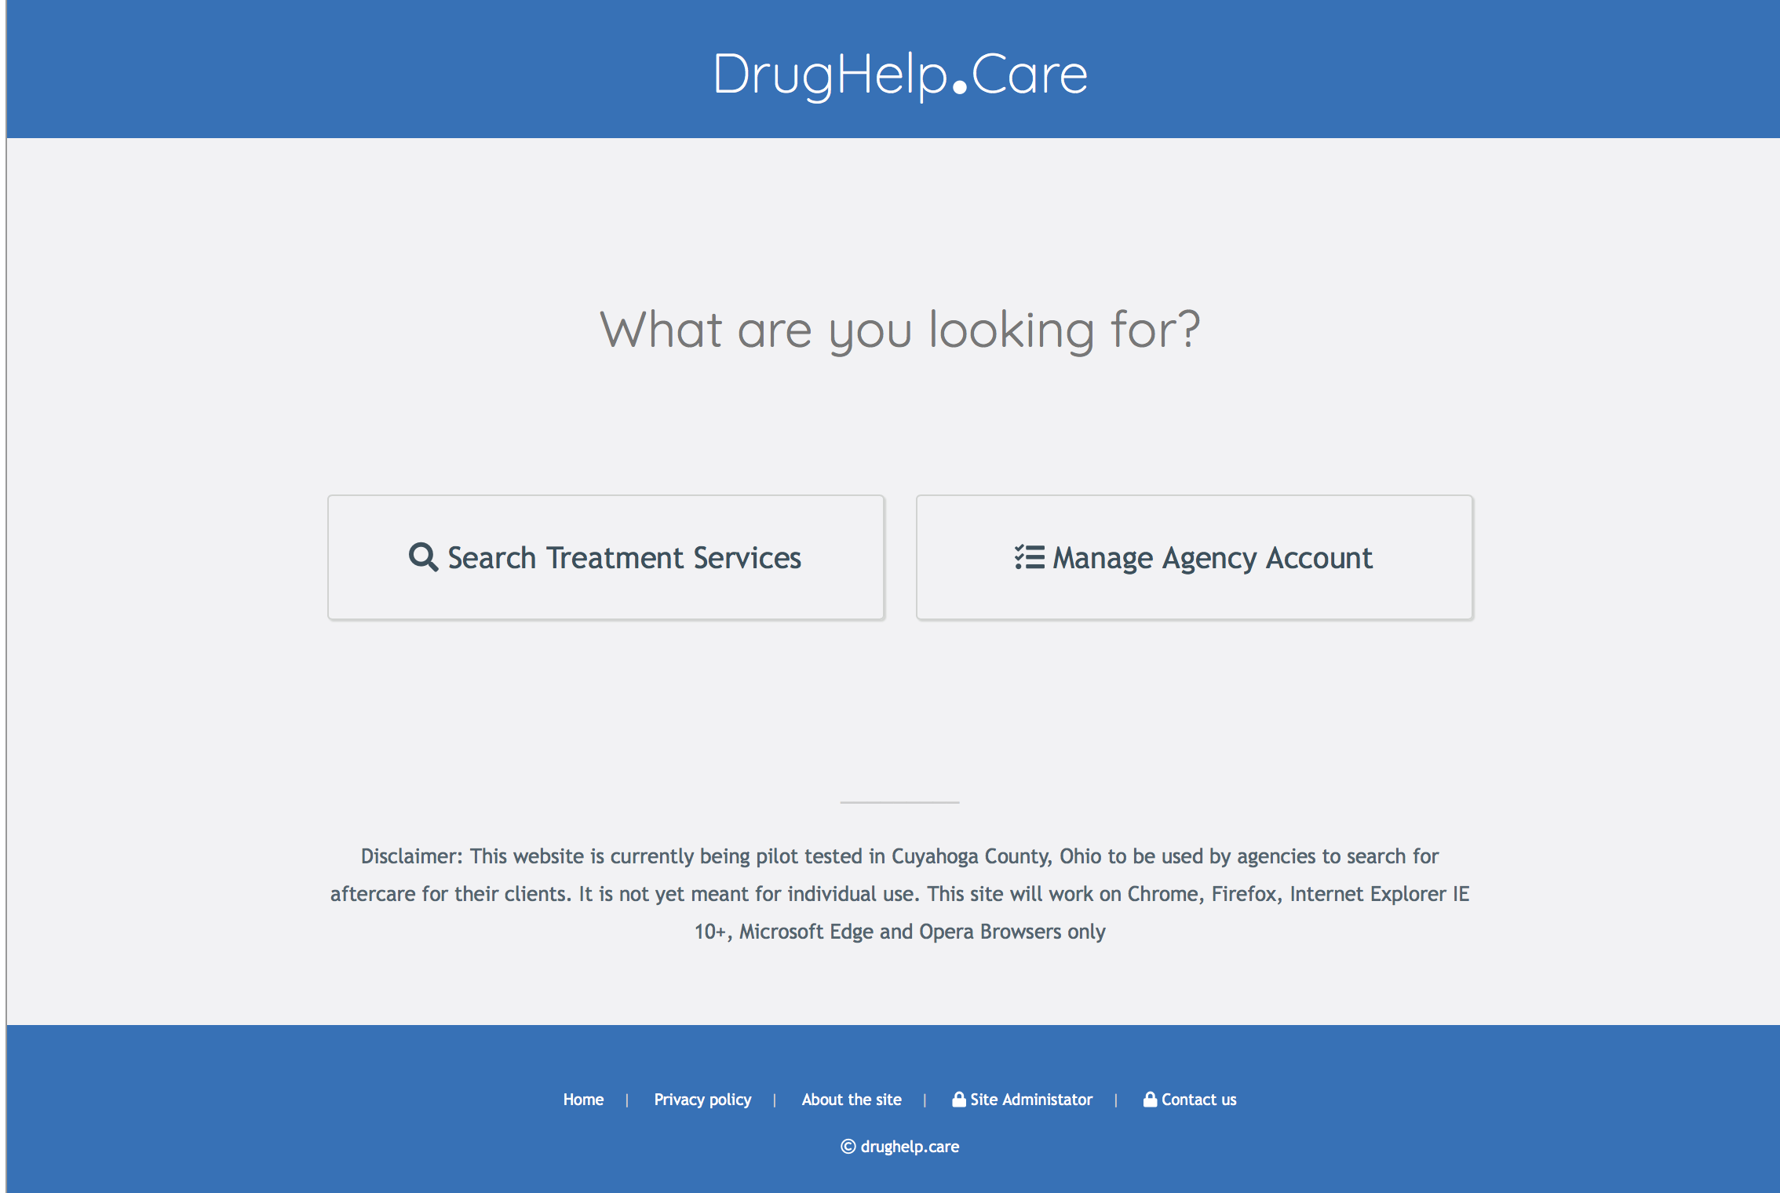
ho are lookin for Treatment Providers search for treatment Provides search options to match client’s needs

Slide 30
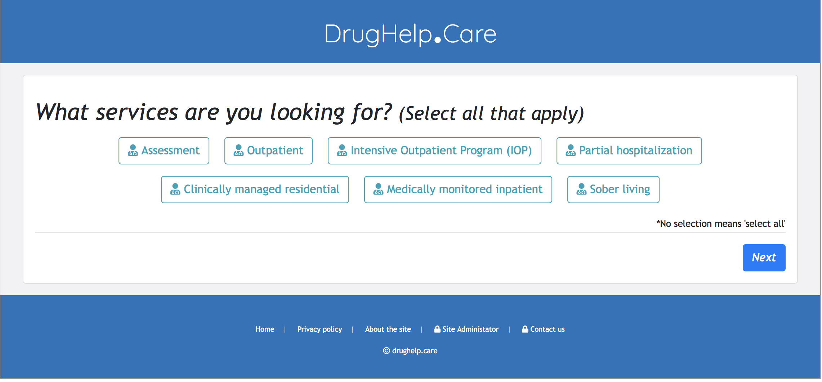
Refinement of Search for Treatment Options

Slide 31
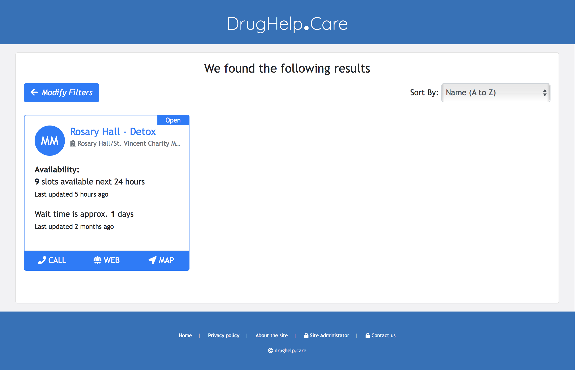
Identifying Specific Tx Option(s)

Slide 32
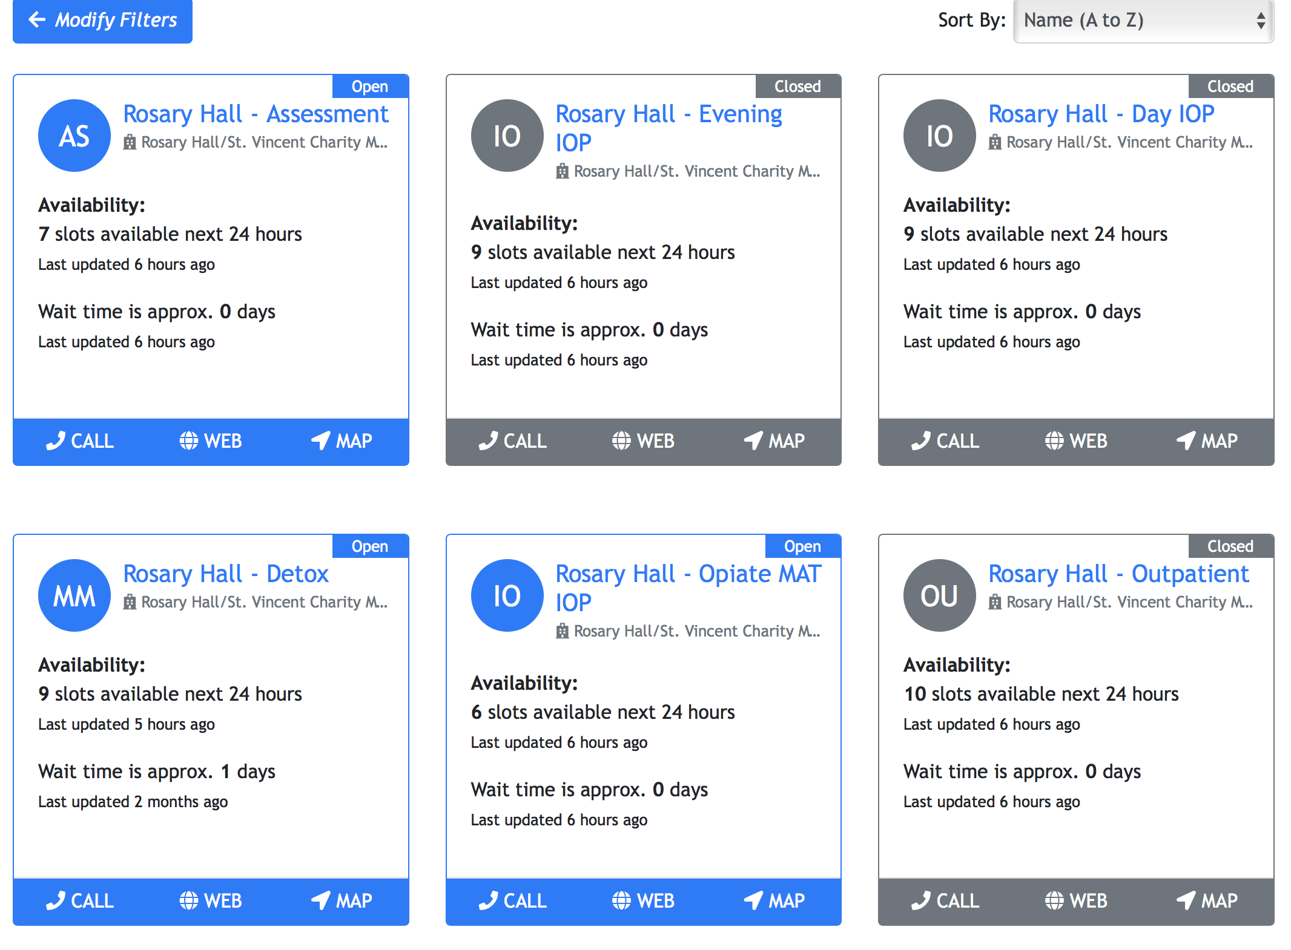
Can also search by all types of services

Slide 33
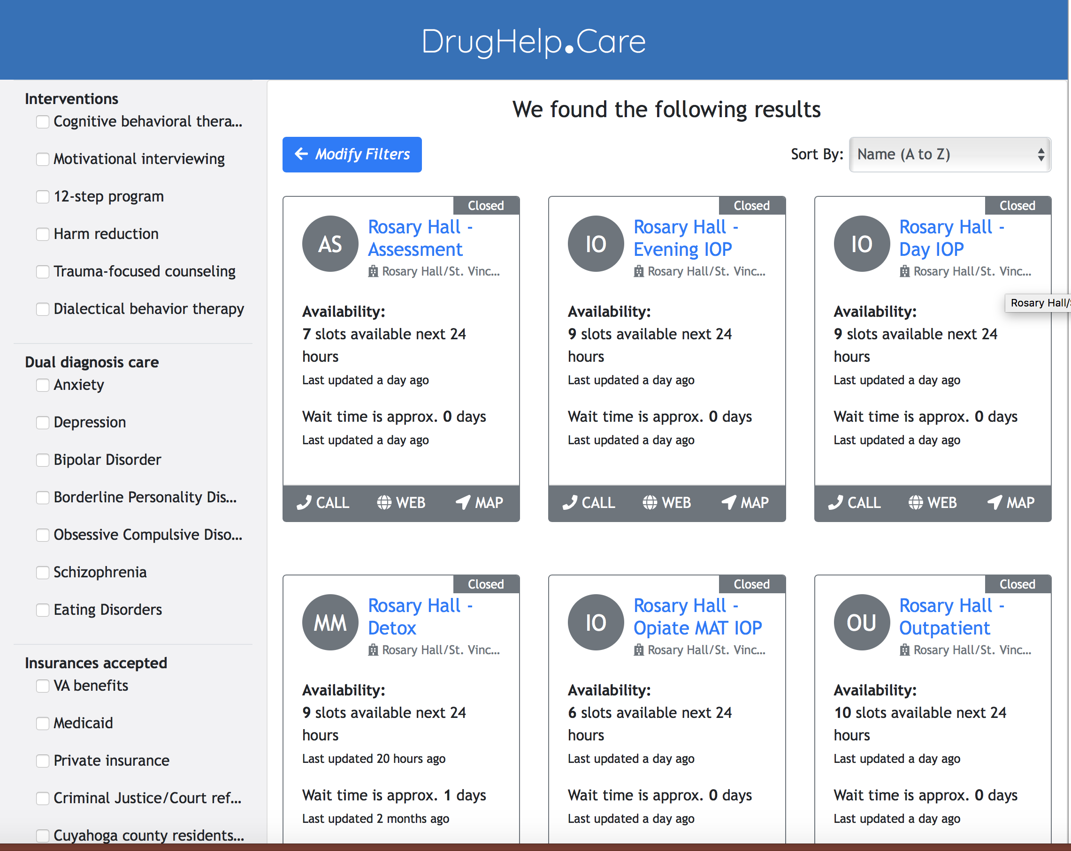
Treatment search based on client characteristics

Slide 34
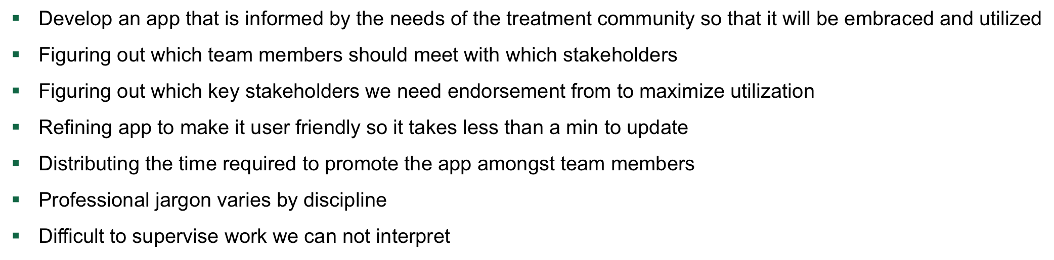
Issues and Barriers

Slide 35
Discussion: Challenges to Interdisciplinary Research
Differences in language, terminology, and theoretical perspectives.
Variations in interpretations of findings.
Different views on how to further unpack the initial findings, next steps, what additional data are needed, etc.

Slide 36
Multidisciplinary Research: Lessons Learned
Learn and appreciate language from respective disciplines
Appreciate and include each discipline’s perspective
Value community partners’ input as true partners
Enhances funding options
Strengthens real-world applications and relevance

Slide 37
Questions and Discussion
❓

