Slide 1
Welcome to Advising Occupational Therapy Doctorate Program
Notes:
Welcome to advising for the Cleveland State University Occupational Therapy Doctorate Program.
Please read the Notes section below each slide to ensure you are getting all necessary information.

Slide 2
Contents
What is Occupational Therapy?
Our Program and Curriculum
Admission Criteria
Admission Process
Cost of Attendance
Advising
Stay Connected
Notes:
In this presentation, we will review general information regarding the CSU Occupational Therapy Doctorate (OTD) Program, including curriculum, admissions, and advising. Although this is a comprehensive presentation, students are strongly encouraged to meet individually with an OT advisor to review transcripts and prerequisite course equivalents, complete an Advising Prerequisite Sheet, and discuss individual situations. You can schedule an appointment at
https://www.csuohio.edu/sciences/occupational-therapy/admission-and-advising
Scroll down to the big blue button to set up an appointment.

Slide 3
WHAT IS OCCUPATIONAL THERAPY?
Notes:
Welcome to advising for the Cleveland State University Occupational Therapy Doctorate Program.
Please read the Notes section below each slide to ensure you are getting all necessary information.

Slide 4
What is Occupational Therapy?
“Occupational therapy is a science-driven, evidence-based profession that enables people of all ages live life to its fullest by helping them promote health, prevent—or live better with—injury, illness, or disability. This is accomplished through designing strategies for everyday living and customizing environments to develop and maximize potential.”
The American Occupational Therapy Association, 2011
“Skills for the Job of Living”
The American Occupational Therapy Association
Notes:
What is occupational therapy? This is the question that practitioners have been trying to answer ‘in a nutshell’ for years! Currently, The American Occupational Therapy Association (AOTA) uses this definition:
“Occupational therapy promotes health, well-being, and participation
Occupational therapists and occupational therapy assistants focus on the things (people) want and need to do in (their) your daily li(ves). Occupational therapy intervention uses everyday life activities (occupations) to promote health, well-being, and (the) ability to participate in the important activities in (one’s) life. This includes any meaningful activity that a person wants to accomplish, including taking care of (them)self and (their) family, working, volunteering, going to school, among many others”. AOTA, 2023
OT helps individuals design their lives, develop skills, adjust home, school, or work environments, and build health-promoting habits and routines. Occupational therapists use everyday activities as the means to enable people to thrive; working to get beyond disability or limitations, and creating ways for individuals to live life to its fullest no matter what.
But, it can also be summarized using the slogan….Skills for the Job of Living.

Slide 5
AOTA Video: What is OT?
https://www.aota.org/about/what-is-ot
Notes:
Check out this video link from the American Occupational Therapy Association (AOTA) to learn more about OT!

Slide 6
Occupational Therapy in Action
Notes:
Occupational therapists work with persons across the lifespan with traditional hospital/medical settings, rehabilitation and skilled nursing facilities, mental health settings, schools, and within the community in home health and much more.

Slide 7
OUR PROGRAM AND CURRICULUM
Notes:
Welcome to advising for the Cleveland State University Occupational Therapy Doctorate Program.
Please read the Notes section below each slide to ensure you are getting all necessary information.

Slide 8
Occupational Therapy at CSU
Cleveland State University has offered an entry-level OT program since 1974. Initially as an undergraduate degree, then a Master of OT, and now an Occupational Therapy Doctorate degree.
We are so proud of our graduates and are thrilled to now see some second-generation OT students in our program—children of our alumni!
The Department of Occupational Therapy is a member of the newly formed CSU College of Health https://health.csuohio.edu/

Slide 9
Why CSU?
We prepare our graduates to work in both medical and community-based settings, assuming diverse roles in clinical practice, consultation, teaching, management, research, and advocacy.
Our unique occupation-based hands-on experiences in the community set us apart from other programs. These exceptional opportunities are designed to provide our students with an opportunity to participate in innovative and emerging areas of practice directed toward enhancing engagement in meaningful occupations to improve the quality of life and health of participants.
Our experienced faculty provides high-quality instruction and learning opportunities, preparing graduates to become skilled and ethical practitioners who provide occupational therapy services to diverse individuals, groups, communities, and populations within complex interdisciplinary systems using the best evidence.
Notes:
Our extensive Service Learning programming is something you will not likely see at other schools. Under the supervision of OT faculty, students attend local community agencies to develop and provide programming focused on psychosocial aspects of health for a wide range of populations in an array of settings. Some examples of locations and populations:
An afterschool program at a settlement house for grade school children focused on social-emotional learning.
Programming with older adults in a long-term care setting focused on using occupation to promote physical and mental health.
Group experiences promoting quality of life with community-dwelling adults with developmental disabilities in a workshop setting.
Provision of psychoeducational interventions for veterans on the CSU campus.
Addressing psychosocial needs of inmates through therapeutic groups at a women’s rehabilitation and corrections facility.
Mental health promotion through group experiences at a refugee and immigrant center.
These unique opportunities provide our students exposure to underserved populations and offer them an avenue to design and deliver meaningful and valued services.

Slide 10
Our Faculty
Our faculty have expertise in occupational science, occupational justice, school-based practice, sensory processing challenges, older adults, assistive technology, and population health (promotion, prevention, and intervention), mental health, and much more!
Visit our website for faculty profiles:
https://health.csuohio.edu/occupational-therapy/faculty-and-staff-1
Notes:
The distinction of our program from others lies in our faculty. They bring to the table a wealth of clinical expertise and experience, cutting-edge research, and wholeheartedly dedicate themselves to our students’ success and achievements.

Slide 11
Accreditation Information
Cleveland State University’s entry-level occupational therapy doctoral degree program is accredited by the Accreditation Council for Occupational Therapy Education (ACOTE) of the American Occupational Therapy Association (AOTA), located at 6116 Executive Boulevard, Suite 200, North Bethesda, MD 20852-4929. ACOTE’s telephone number c/o AOTA is (301) 652-AOTA and its web address is www.acoteonline.org.
Graduates of the program will be eligible to sit for the national certification examination for the occupational therapist administered by the National Board for Certification in Occupational Therapy (NBCOT). After successful completion of this exam, the individual will be an Occupational Therapist, Registered (OTR).
In addition, all states require licensure in order to practice; however, state licenses are usually based on the results of the NBCOT Certification Examination. Note that a felony conviction may affect a graduate’s ability to sit for the NBCOT certification examination or attain state licensure.
Notes:
The CSU OT Program has been accredited for the entirety of its existence. Most recently, our OTD Program was fully accredited by the Accreditation Council for Occupational Therapy Education (ACOTE) in 2022.

Slide 12
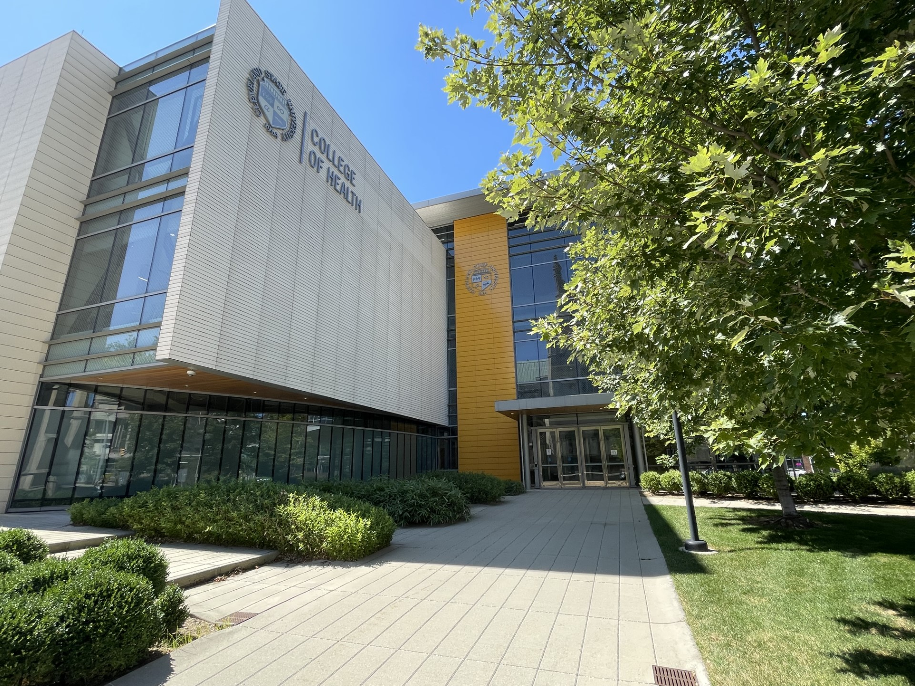
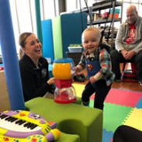
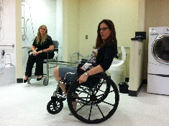
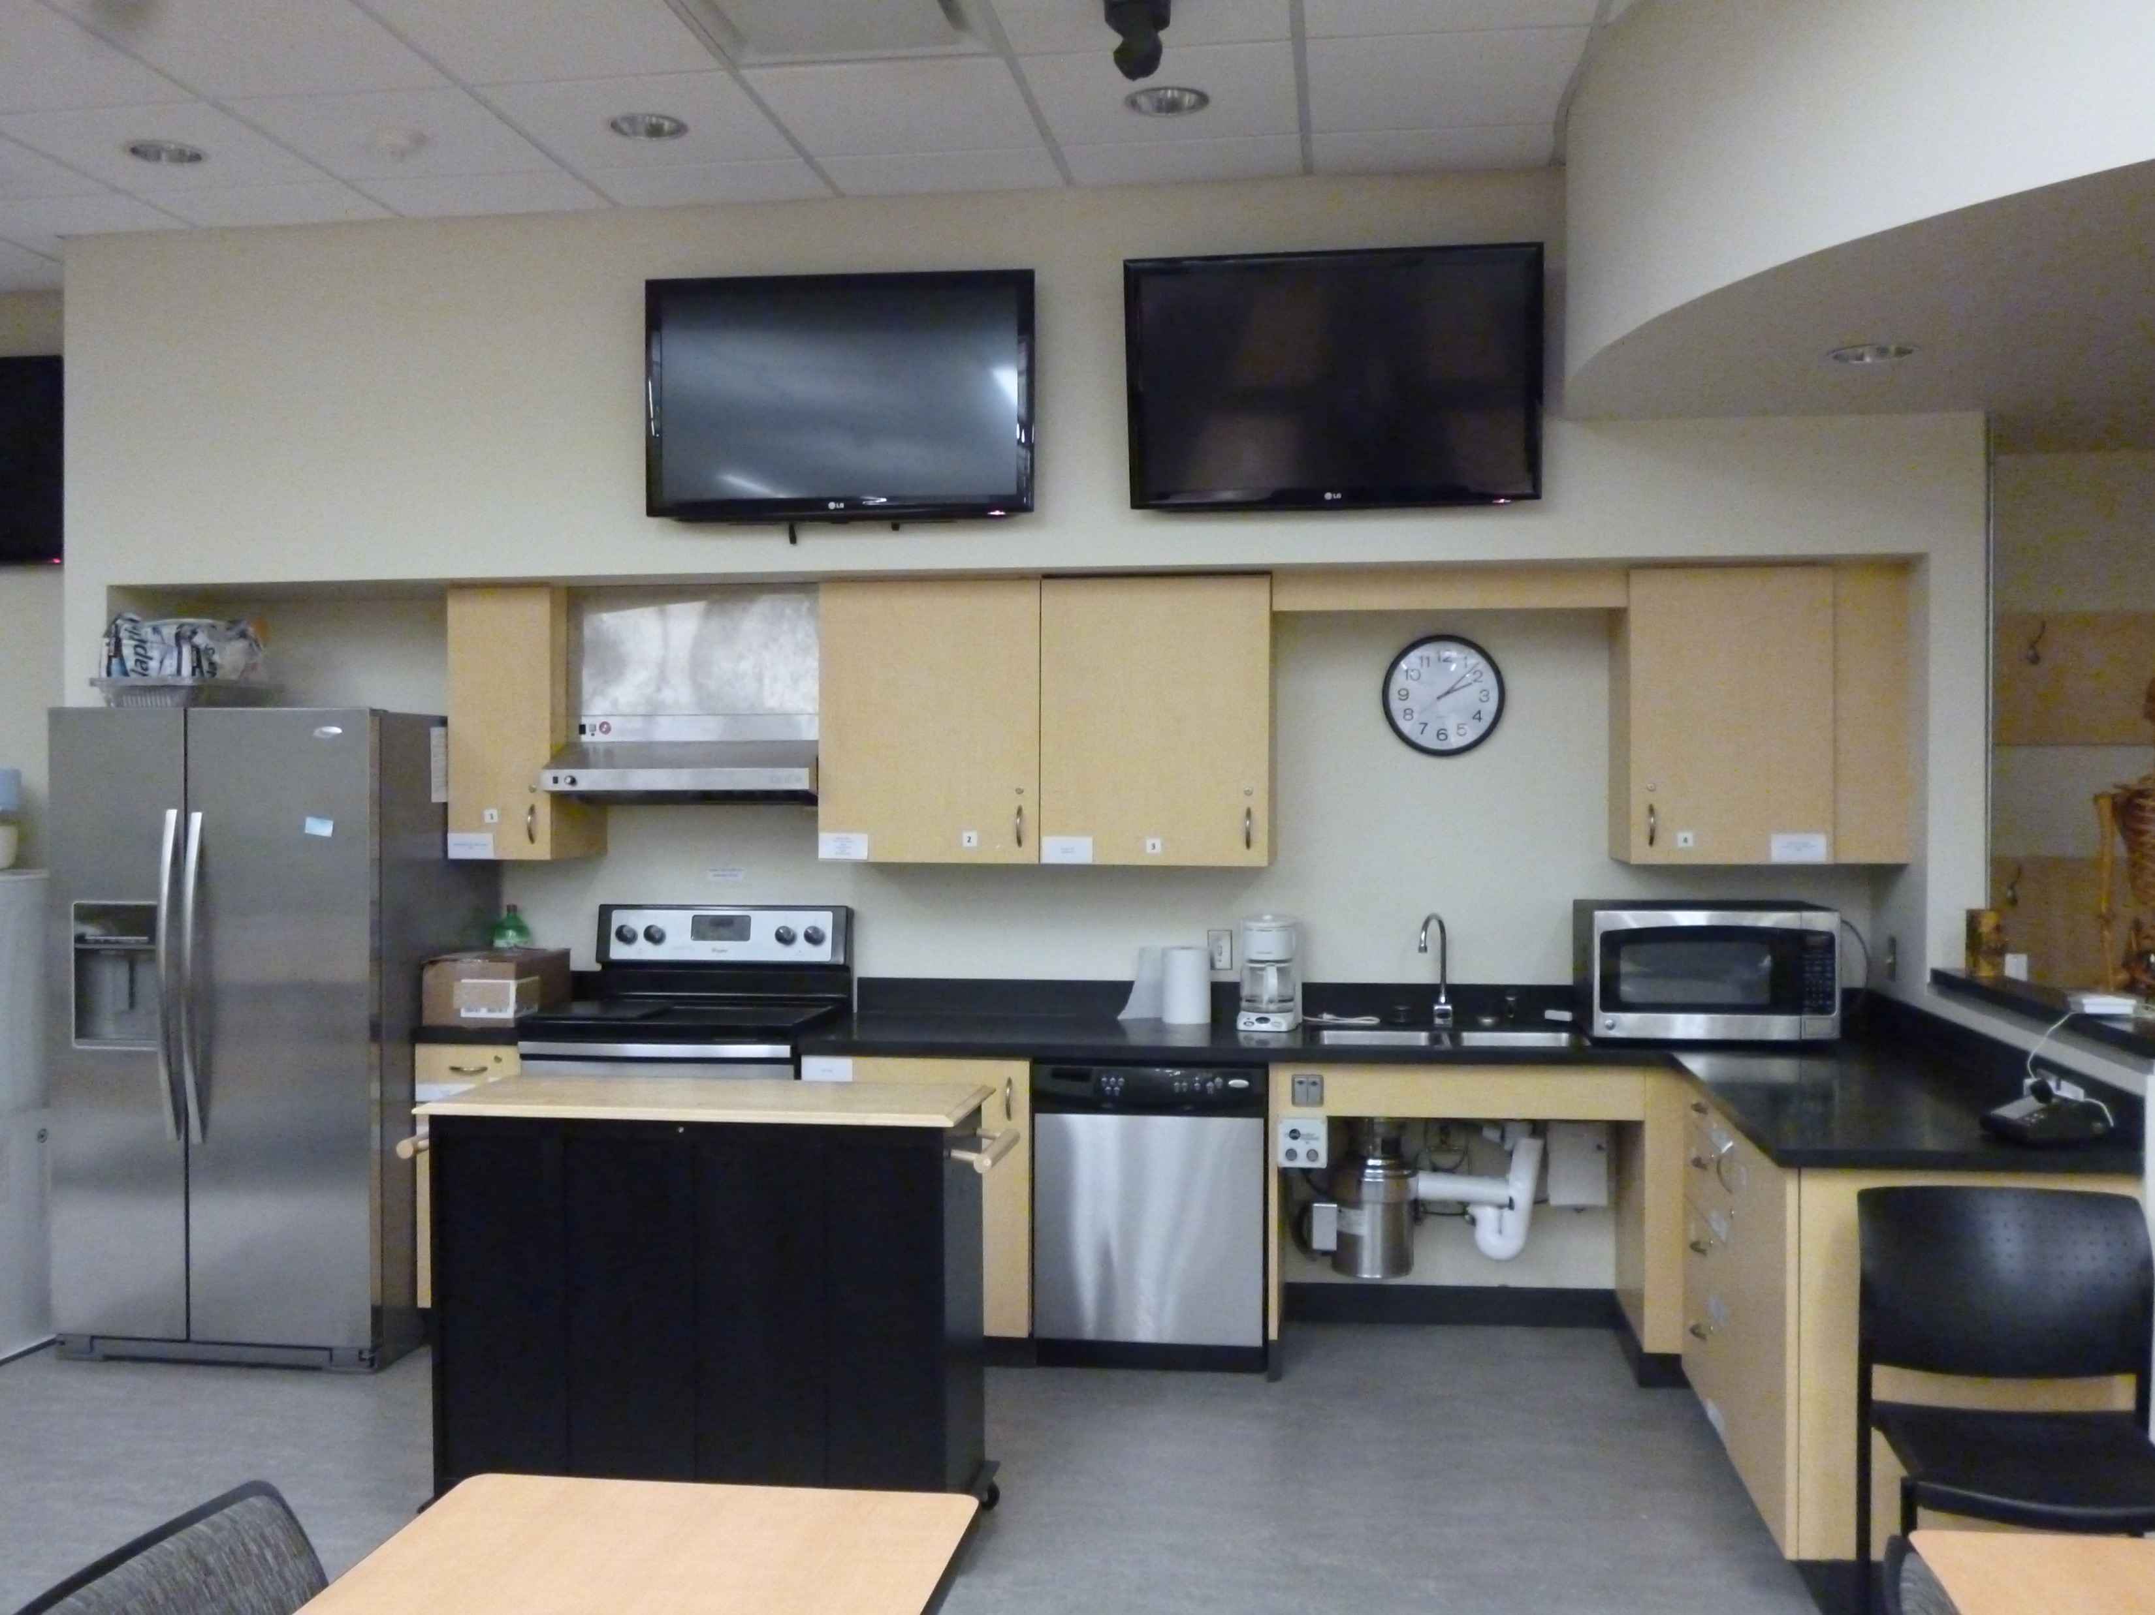
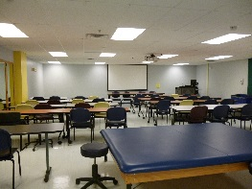
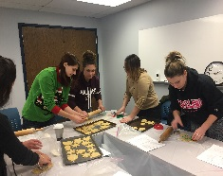
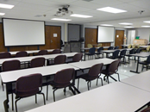
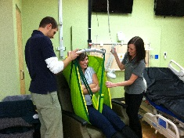
Our Learning Spaces
Notes:
We have state of the art classroom and lab space.

Slide 13
Our OTD Curriculum
Begins in fall semester
Includes
6 months/2 semesters of full-time, unpaid fieldwork
1 full-time semester for the doctoral capstone
8 consecutive semesters over 33 months
Weekday only program
Total of 103 credit hours
56 credits in core area
22 credits of clinical experiences
2 elective courses
18 credits of doctoral capstone
Notes:
Our program begins in fall semester. Every year, 45 students are admitted as a cohort and travel together through the full-time, lock-step, academic program for 8 consecutive semesters (33 months), including summer.
At the conclusion of the 5 semesters on campus, students must pass a competency exam before beginning their 6 months/2 semesters of full-time fieldwork education (two separate 3-month experiences). Fieldwork is credit-bearing and graded; experiences are unpaid and require participation in an accompanying online course. Students are required to complete one fieldwork experience out of town, meaning greater than 100 miles from CSU.
In their final (8^{th)} semester, after they complete their Fieldwork rotations, students complete a 16-week Doctoral Capstone experience and project.
Although some elective courses may be held in the evening or online, the core courses for the program are usually held weekdays from 8am to 5pm. Each semester, the class schedule will vary, and although classes will not be held 40 hours each week, flexibility is expected and students should make themselves available those hours for field trips, group project meetings, field placements, study groups, library and computer lab time.
The 103 credit hours of the curriculum include:
56 credit hours in the core area, including a research project completed in a small group
22 credits of clinical experience, both
part-time (2 practica and 1 service learning experience, each with corresponding classroom sessions) and
full-time (2 separate 12-week fieldwork experiences at the conclusion of all academic work)
1 credit for competency examination and preparation
6 credits of elective courses meant to provide students with in-depth knowledge in areas relevant to practice and their capstone
18 credits of doctoral capstone including 3 preparatory seminar courses, the doctoral experience, and doctoral project

Slide 14
Field Placements
Level I Fieldwork
1 Service Learning
2 Practicum
Level II Fieldwork
Notes:
LEVEL I FIELDWORK:
Students participate in two types of Level I experiences.
-One service learning that focuses on psychosocial factors and health promotion and
-Two practicum experiences encompassing an array of medical model, community-based, and
emerging areas of practice.
These experiences are rotated during three semesters. Our Service Learning program offers unique learning opportunities through signature community-based programs that focus on occupation-based practice and health promotion of individuals, groups, and populations.
For all part-time experiences, students will be under the supervision of an occupational therapist one day/week and have a corresponding weekly classroom session. Students may need to drive up to one hour to their clinical sites.
Level II Fieldwork: The final, full-time experiences, occur after the completion of all academic work. Students will be on-site full-time (40+ hours/week) under the supervision of an occupational therapist at two different sites (3 months each/total 6 months). One 3-month rotation will be out of town, meaning at least 100 miles from the CSU campus. If students cannot go out of town, they may petition the faculty to remain closer to home.
Students will provide preferences for all placements, but ultimate decisions are the responsibility and at the discretion of, the program’s Academic Fieldwork Coordinator.
All students will receive a background check as part of their clinical placement process. Clinical sites have the right to refuse a student placement based on background check results. Please see an OTD advisor with individual questions. NOTE: If you have any history of misdemeanors or other legal issues that may show up on a background check (underage drinking, DUI, etc), you may not be accepted for participation at some clinical placements. These decisions are solely at the discretion of the sites, so it is in the student’s best interest to investigate the process for sealing or expunging his/her record as soon as possible.

Slide 15
Doctoral Capstone
18 credits
3 seminars prepare students to develop their capstone
Students complete their capstone experience and project during the last semester of the program
Notes:
The Doctoral Capstone process is comprised of both classroom and independent, but supervised, work. The necessary background is provided in 3 structured classes that occur during the on-campus portion of the program. Additionally, students work with an assigned faculty member to develop the proposal for their experience and project. These classes are credit-bearing and graded.
Following successful completion of the two full-time fieldwork rotations, students complete their full-time doctoral capstone experience (14 weeks) and project completion (2 weeks).

Slide 16
The Capstone Experience
Minimum of 14 weeks (560 hrs)
Activities and work must be consistent with the individualized specific objectives and culminating capstone project.
Notes:
The content of the 14-week experience is created by the student with direction from the capstone site mentor and faculty capstone advisor.

Slide 17
The Capstone Project
Students will complete an individual capstone project related to their doctoral capstone experience
Students will disseminate their work during a formal capstone forum
The project must demonstrate a synthesis of in-depth knowledge in the focused area of study
Notes:
At the conclusion of the final semester, students will present their capstone experiences and projects to the community.

Slide 18
Part-Time Students
Same application process
Apply for part-time once admitted to the OT Program
Program length increases from 33 to 40 months
First year divided into 2 years
Final year (fieldwork and capstone) same as standard schedule
Notes:
There is not a separate admission process for part-time students; students are required to use OTCAS and follow the same admission criteria and deadlines as those desiring a full-time program.
Students desiring a part-time schedule will petition the OT faculty after they have been accepted to the OTD Program.
The part-time program essentially splits the first academic year into two years. The final year, fieldwork, and the capstone experience follow the same schedule as the full-time program. Any alterations to this must be approved by the faculty. The length of the part-time program is 40 months.

Slide 19
Post-Graduation Details
Fieldwork and capstone must be completed within 24 months of completion of the academic coursework
National certification exam www.nbcot.org
Ohio Licensure http://otptat.ohio.gov
A felony conviction may affect a graduate's ability to sit for the exam or attain state licensure required to practice as an OT
Other legal issues
Notes:
Successful completion of the academic program includes the caveat that both full-time fieldwork rotations and the capstone experience and project must be completed within 24 months of the end of academic coursework.
Once students successfully complete both the academic and clinical aspects of the OTD Program, including the capstone experience and project, they are eligible to sit for the national certification exam administered by the National Board for Certification in Occupational Therapy. To practice as an occupational therapist, a graduate must pass the board exam.
To practice in Ohio, a graduate must also attain Ohio state licensure.
Details on the certification exam and Ohio licensure are available at the websites on the slide above.
Additionally, please note that a previous felony conviction may affect a graduate’s ability to sit for the national certification exam and attain a state license. Please direct any individual questions to NBCOT and/or the Ohio Licensure Board.

Slide 20
ADMISSION CRITERIA
Notes:
Welcome to advising for the Cleveland State University Occupational Therapy Doctorate Program.
Please read the Notes section below each slide to ensure you are getting all necessary information.

Slide 21
Current Admission Criteria
Competitive admission
Specific Criteria:
Bachelor’s degree
Minimum overall GPA 3.0 OR GRE score of 50th percentile or greater in all areas
Prerequisite GPA 3.0 or above.
Score for the OT Program-Specific essay uploaded to OTCAS
Non-native English speakers must meet criteria set by the College of Graduate Admissions
Notes:
The OTD Program uses a competitive admission process based on the following criteria:
Students must have
1-a bachelor’s degree from an accredited institution, completed by the fall start date of the OTD Program
2-a minimum cumulative grade point average of 3.0 OR a GRE score of 50th percentile or greater in all areas.
3-a prerequisite grade point average of 3.0 or above (this is based on the OTD prerequisite courses), with all courses completed with a “C” grade or better.
4-Additionally, the OT Program-specific application essay (located in the online application system, OTCAS) is scored and used in the overall application score. The essay should be entered into the special section identified for CSU. Instructions and writing prompt are available in OTCAS.
5-Non-native English speakers must meet university criteria for graduate admission. More information is available from the CSU International Admissions office at https://www.csuohio.edu/international-admissions/international-admissions
Additional application points will be awarded to students demonstrating completion of all admission coursework requirements by the October application deadline

Slide 22
Not Required, but Recommended
Volunteer hours
2 areas of practice are recommended
Notes:
The CSU OTD Program does not require students to complete volunteer hours, but it is STRONGLY recommended that students gain experience under the supervision of occupational therapists in at least two areas of practice to provide them with a better understanding of the profession in action.

Slide 23
Prerequisite Requirements (1 of 2)
FOUR prerequisite courses, including one required natural sciences, must be completed by the time the application is submitted
The prerequisite GPA in these courses must be 3.0 or higher at time of application submission:
Natural Sciences:
Physiology with lab (OR Anatomy and Physiology I and II)
Human Anatomy with lab
Neurosciences with lab
Pathology
Social Sciences
Lifespan/Development
Abnormal Psychology
Social Science (research-based) Statistics
Medical Terminology
Refer to the CSU OTD Program website for course numbers/names recommended at CSU and a course equivalency chart for other Ohio schools.
Notes:
A bare minimum of four of the eight prerequisite courses, including one of the natural sciences, must be completed with a prerequisite GPA of 3.0 or higher by the time of application submission. All 8 prerequisite courses must be completed BEFORE the fall start of the OTD Program
Natural Sciences:
-Physiology with a lab (OR Anatomy and Physiology I and II, counts as ONE science equivalent—physiology only--NOT as two courses)
-Human Anatomy with a lab
-Neurosciences with a lab (NOT Behavioral Neuroscience; course must cover motor control/systems)
-Pathology
Social Science Prerequisite courses are:
-Lifespan/Development
-Abnormal Psychology
-Social Science Statistics/Research
-Medical Terminology
Refer to the CSU OTD Program website for course numbers/names recommended at CSU and a course equivalency chart on our website referencing classes at other Ohio schools. If you have taken courses at schools not listed on the equivalency chart (see OTD website), please make an appointment with an OTD advisor for approval of equivalency. You may be asked for a catalog description and/or a syllabus so we can determine if the course is equivalent. The CSU OTD Program is under no obligation to accept courses as equivalents if they have not been pre-approved.
Many of the OTD prerequisite courses are upper division and have prerequisites. It is the applicant’s responsibility to be aware of and complete any additional required courses.
If you will take prerequisite courses at CSU but not be receiving a degree, you should apply as a non-degree undergraduate student.

Slide 24
Prerequisite Requirements (2 of 2)
“C” grade or better in all prerequisite courses but overall prerequisite GPA must be 3.0 or higher
All 8 prerequisite courses must be completed BEFORE the fall start of the OTD Program
*Many of the OTD prerequisite courses are upper division and have prerequisites. It is the applicant’s responsibility to be aware of and complete any additional required courses.
Notes:
All prerequisite coursework must be completed with a grade of C or better.
Please note! The application deadline is October 1st, so a minimum of one of the four science courses plus three other courses must be completed by the conclusion of the summer prior to application in order for applicants to submit those transcripts to OTCAS.
*Plan carefully: many of the courses have prerequisites that must be completed prior to the course required by the OTD program. Make sure you have enough time after applying to the program to complete all required prerequisites.

Slide 25
Prerequisite Course Equivalency Chart https://health.csuohio.edu/occupational-therapy/admission-and-advising Scroll down to the section titled Prerequisite Course Requirements and download the Excel file
Notes:
https://health.csuohio.edu/occupational-therapy/admission-and-advising
Go to the link above and scroll down to the section titled Prerequisite Course Requirements
There, you can download an Excel (one for Ohio, one for non-Ohio schools) that lists courses that our program has reviewed and determined equivalency to our required prerequisite courses. Each school has a tab across the bottom of the document; click on it to access the courses previously reviewed for the desired school.
If you do not see a course or school of interest to you, please make an appointment with the OT advisor (see slide 31) to discuss.

Slide 26
ADMISSION PROCESS
Notes:
Welcome to advising for the Cleveland State University Occupational Therapy Doctorate Program.
Please read the Notes section below each slide to ensure you are getting all necessary information.

Slide 27
Admission Process
Application available by August 1st annually
Application deadline October 1 of the year PRIOR to anticipated admission
Submit ALL transcripts to OTCAS
Competitive admissions
OTCAS system
Notes:
Applications for the OT Program are available by August 1st and are due on or before October 1 of the year prior to anticipated admission. Applications must be complete for an applicant to be considered for admission.
Admission is competitive, so all applications will be reviewed before admission decisions are made. Early submission of an application does not provide a competitive advantage, but all applications must be received by the October deadline.
CSU OT Program uses the OTCAS online system for applications (see next slide)
Please be sure to submit ALL OF YOUR COLLEGE LEVEL TRANSCRIPTS to OTCAS so your application may be processed in a timely manner.

Slide 28
Admission Process
OTCAS-Occupational Therapy Centralized Application System (OTCAS)
Available online at https://otcas.liaisoncas.com/applicant-ux/#/login
Due date: October 1st for fall admission of following year
Application fee $159 for one school; $69 for each additional school
Office of Graduate Admissions, CSU
No fee required
Due date: after acceptance to OTD Program
Notes:
The admission process starts a year in advance of beginning the OTD Program.
OTCAS is a centralized system, like the ‘common app’ for undergraduate college, and applications can easily be sent to multiple schools. CSU applications are available online by August 1st and are due October 1st of the year prior to anticipated admission. The application fee is $159 to have the application sent to 1 school; a $69 fee applies for each additional school.
All required information must be submitted to and received by OTCAS by October 1st of the year prior to anticipated admission.
Please note: the CSU OTD Program does not require letters of reference, however, you will need to enter the names of 3 references on OTCAS. If a student is applying to other schools, they may require reference letters. It is the student’s responsibility to ensure that the correct and complete information is submitted according to the due dates.
Once admission to the CSU OTD Program is confirmed, students should apply to the CSU College of Graduate Studies for admission to the university. Refer to the website for procedures. DO NOT apply to the CSU College of Graduate Studies until you have been accepted into the CSU OTD Program.
https://grad.engagecsu.com/apply

Slide 29
When Is My Application Complete?
OTCAS application and fees submitted
ALL college-level OFFICIAL transcripts sent to OTCAS
Minimum of 4 prerequisites, including a minimum of 1 required Natural Science course (or equivalent) completed by application deadline.
Reasonable plan to complete undergrad degree and ALL REMAINING prerequisite coursework documented on the application
Notes:
Your application must be complete to be considered for admission to the CSU OTD Program.

Slide 30
Application Scoring
Application Scores are based on the following criteria:
Prerequisite coursework GPA
Overall GPA or GRE score (*see note)
Application essay (school-specific)
Bonus points
Notes:
*NOTE: If a student does not have an overall GPA of 3.0 or greater, we will accept GRE scores as an equivalent. However, in order to be eligible to apply, the GRE quantitative and verbal score must each be at or above the 50th percentile.
If applications are submitted with ALL 8 prerequisites complete, applicants receive a small bonus on the application score.

Slide 31
How Will I Be Notified of My Status?
Application processing time
Acceptance or rejection
Regular
Provisional
Waiting List
Rejection
Notes:
The OT Program receives 150 or more applications annually. Grade point averages are computed by OTCAS and reviewed by faculty, Program specific essays are read and scored by a team of OT faculty. This process is lengthy but allows us to ensure that every application is given the individual attention it deserves.
By December or January, notice is sent to applicants through OTCAS via email. There are four types of notifications:
1-Regular acceptance indicates the student has met and completed all admission requirements and is invited to begin the program in the fall.
2-Provisional acceptance indicates a student has met the standards for admission and will be admitted in the fall if all of the required prerequisite coursework has been completed and minimum admission standards are maintained. Failure to complete all necessary the prerequisites or an undergraduate degree, or failure to maintain admission standards will forfeit an accepted student’s place in the class.
3-Waiting List indicates the student has met the minimum standards for admission but is not within the top 45 applicants. If students in regular or provisional acceptance categories decline admission, students on the waiting list will be contacted in order of rank.
4-A rejection letter will be sent to applicants who do not meet the minimum admission standards.

Slide 32
Credit for Previous Work
Once accepted into the OTD Program, students who have previously taken graduate courses at CSU or at universities other than CSU can petition to have the courses accepted to meet the OTD elective requirement, if the credits have been “earned at an accredited graduate college or university and not utilized to fulfill a requirement for any other degree”.
These credits must carry a letter grade of a B or higher, and all elective credits must be within the six-year statute of limitations imposed by the CSU Graduate College.
Prior course work needs to provide students with in-depth knowledge that will be relevant to practice and their doctoral capstone
Notes:
The student should submit the petition with the necessary supporting documents to his/her OTD faculty advisor once the program begins. In addition, the student should indicate how prior course work provides the student with in-depth knowledge that will be relevant to practice and their doctoral capstone. The OTD Program does not accept any 400-level courses for transfer as graduate electives.

Slide 33
COST OF ATTENDANCE
Notes:
Welcome to advising for the Cleveland State University Occupational Therapy Doctorate Program.
Please read the Notes section below each slide to ensure you are getting all necessary information.

Slide 34
Cost of the OT Program
Tuition
Lab Fees
Books and supplies
Fieldwork cost
Graduate Assistantships
Scholarships
Notes:
For in-state students, tuition is currently approximately $8400 plus fees per academic semester. Tuition and fees are subject to change. Students pay for 8 semesters. Some courses carry lab fees, others do not, so this cost will vary from semester to semester. Many books and materials are used in multiple semesters.
For current information on TUITION AND FEES, refer to https://www.csuohio.edu/sites/default/files/Graduate%20InState%20Fee%20Schedule_3.pdf
There are often fees associated with field placements (full and part-time)—background checks, drug screens, onboarding fees, parking, badges, etc. These fees, along with all of the costs related to travel and living expenses, are solely the responsibility of the student.
Limited graduate assistantships are available within the OT Program for second-year students in their fall and spring semesters. These provide students with a stipend each semester in exchange for work (up to 10 hours per week). Other GA positions are also available in many departments on campus, but students will need to independently investigate those opportunities.
Some scholarships are available from outside sources (AMBUCS, AOTA, AOTF, etc).

Slide 35
ADVISING
Notes:
Welcome to advising for the Cleveland State University Occupational Therapy Doctorate Program.
Please read the Notes section below each slide to ensure you are getting all necessary information.

Slide 36
OTD Advising
Our advisor can help you with:
Transcript review
Prerequisite course approval
Answering your questions related to admissions or the program itself
Planning prerequisite coursework
To schedule an appointment, please use our online scheduler, accessible with the big blue button on this page:
https://www.csuohio.edu/sciences/occupational-therapy/admission-and-advising
Notes:
If you would like an advising appointment with a member of the Occupational Therapy Program faculty, please use the online scheduling tool at this link: https://www.csuohio.edu/sciences/occupational-therapy/admission-and-advising
Be sure to scroll down to the big blue button. Every applicant is encouraged to meet with an advisor from the OT Program prior to application. Appointments occur by phone call.
All questions about undergraduate degree completion should be made to the College of Health Student Services Center (see previous slide for contact information) as the OT advisor cannot provide guidance on undergraduate degrees.

Slide 37
Bachelor of Science in Health Sciences Degree (BSHS)
Pre-OT Track
Up to 15 students each year
College of Health Student Services Center https://health.csuohio.edu/advising/college-health-student-services-center
Notes:
If you are looking for a major that will prepare you for admission to the CSU OT Program, you may be interested in our BACHELOR OF SCIENCE IN HEALTH SCIENCES PRE-OT TRACK. This degree uses the required prerequisites for OT admission as the core of the undergraduate degree.
For more information on this degree, visit the Health Sciences and Human Performance Department website at
https://health.csuohio.edu/health-sci/bachelor-science-in-health-sciences-bshs
The OT Program reserves 15 spots for CSU BSHS Pre-OT students. The Pre-OT students will compete among themselves for the reserved slots using the program admission requirements. Qualified students who do not gain admission through this process will still be considered for admission again with the larger pool of applicants. The BSHS students will use OTCAS to apply and are required to maintain the same standards as our typical admissions.
The College of Health Student Services Center has advisors who can help you plan your undergraduate degree and prepare for OT admissions.
https://health.csuohio.edu/advising/college-health-student-services-center

Slide 38
STAY CONNECTED
Notes:
Welcome to advising for the Cleveland State University Occupational Therapy Doctorate Program.
Please read the Notes section below each slide to ensure you are getting all necessary information.

Slide 39
Stay Connected!
CSU Department of Occupational Therapy
https://health.csuohio.edu/occupational-therapy/occupational-therapy
CSU OT Program on Facebook
https://www.facebook.com/profile.php?id=100057474248698
CSU OT Program on Instagram
@OTcsuOhio
Notes:
Nothing stays the same, and the OT Program often has updates and information relative to admissions and curriculum that may be important to you. A great way to keep in touch with us is by checking our website at regular intervals or following our program on Facebook and Instagram.

Slide 40
Cleveland State Links
CSU OTD Program and link to advising appointment scheduler:
https://www.csuohio.edu/sciences/occupational-therapy/admission-and-advising
Office of Graduate Admissions: http://www.csuohio.edu/gradcollege/admissions/apply.html
Notes:
Here are links that may be helpful to you.
The Course Equivalency Chart is updated periodically. If you have taken a course not identified on the chart, please contact the OT Program to inquire about equivalence for prerequisite credit.

Slide 41
OT Links
American Occupational Therapy Association
www.aota.org
American Occupational Therapy Foundation https://www.aotf.org/Scholarships
National Board for Certification in Occupational Therapy
www.nbcot.org
Ohio OT Licensure Board
www.otptat.ohio.gov/Home.aspx
Explore Health Careers.org
https://explorehealthcareers.org/career/occupational-therapy/occupational-therapist/
Bureau of Labor Statistics
http://www.bls.gov/ooh/healthcare/occupational-therapists.htm
US News and World Report
http://money.usnews.com/careers/best-jobs/occupational-therapist

Slide 42
Cleveland State University College of Health Occupational Therapy Doctorate Program 2121 Euclid Avenue, HS 101 Cleveland, OH 44115-2214 216. 687.3567 ot@csuohio.edu https://www.csuohio.edu/sciences/occupational-therapy/doctor-occupational-therapy
Notes:
Thank you for viewing this Pre-OTD advising presentation; we hope you found this presentation helpful. For individualized advising, please contact us to set up an appointment.

